Slide 1
Cyber Security & DARKNET

Slide 2
Cyber Crimes
Target Computer
Weapon Computer

Slide 3
How it is committed ?
Viruses
Malware
Trojans
Bots
Cryptography
…………………………………

Slide 4
STUXNET
Created in 2010 NSA, CIA & Israel
Targets PLCs & SCADA systems
Parts
Worm
Rootkit
Link File

Slide 5
Hidden Internet
Cover about 90% of internet
Cannot be access by regular search engine
Access tools
TORR
I2P
FreeNet

Slide 6
DEEP WEB
Free from Crimes
Used by government, Business industries, Online banking, money transfer & other works
Online trading
Access is legal
Torr Browser
IP remain real

Slide 7
The DARKNET
The 3rd layer of internet
Uses by Police, Intelligence, Generalist & Criminals
Anonymity
Buy and sell everything
Encrypted
Need special access
Customizes IP addresses
Private Chat Rooms

Slide 8

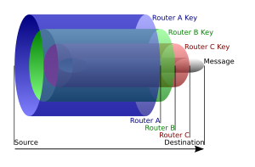
Developed by US NAVY
Access point for DARKNET
Bounces IP addresses
Websites names are complex1ed
i.e. “hss78str77uyxxvyshjfooda1982hgd.DPR.onion” Address of Silk Road

Slide 9
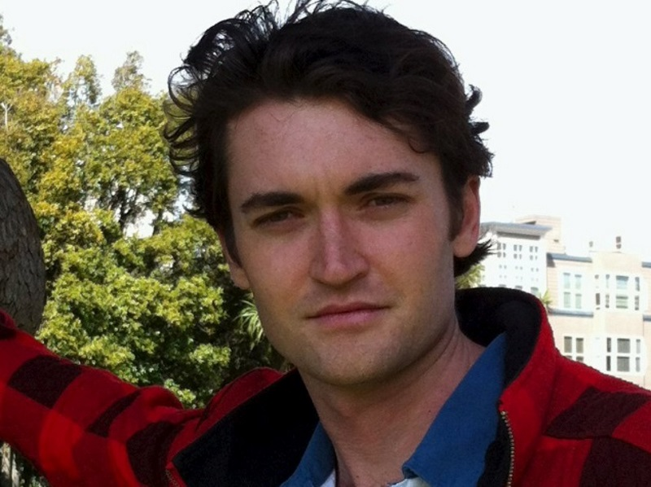
Silk Road
Anonymous market place
Founder Ross Alburt
Dread Pirates Roberts (DPR)
Earn more than 180 million $
silk road version 1.0
Silk road version 2.0
silk road version 3.0 (reloaded)
Operation Marco polo
FBI 2012, 2014
Currency Bit coin (Untraceable)

Slide 10
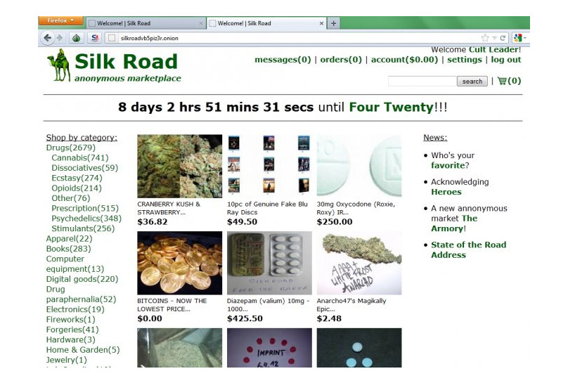
Add a Slide Title - 4

Slide 11
